Slide 1
Computer vision and deep learning
Lecture 5

Slide 2
Training a neural network

Slide 3
Training a neural network
Weights initialization

Slide 4
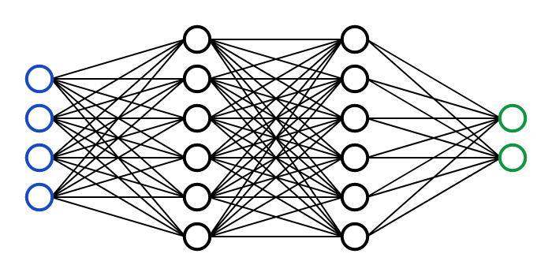

How not to initialize: zero weights
No symmetry breaking

Slide 5
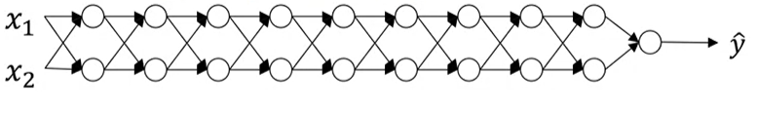
Vanishing and exploding gradients
Image source: https://www.coursera.org/learn/deep-neural-network/lecture/C9iQO/vanishing-exploding-gradients

Slide 6
Weight initialization Example credit: Andrew Karpathy
https://colab.research.google.com/drive/1CvCXZIevs6MvQnldyG2UHZevG0bKaeiu?usp=sharing

Slide 7
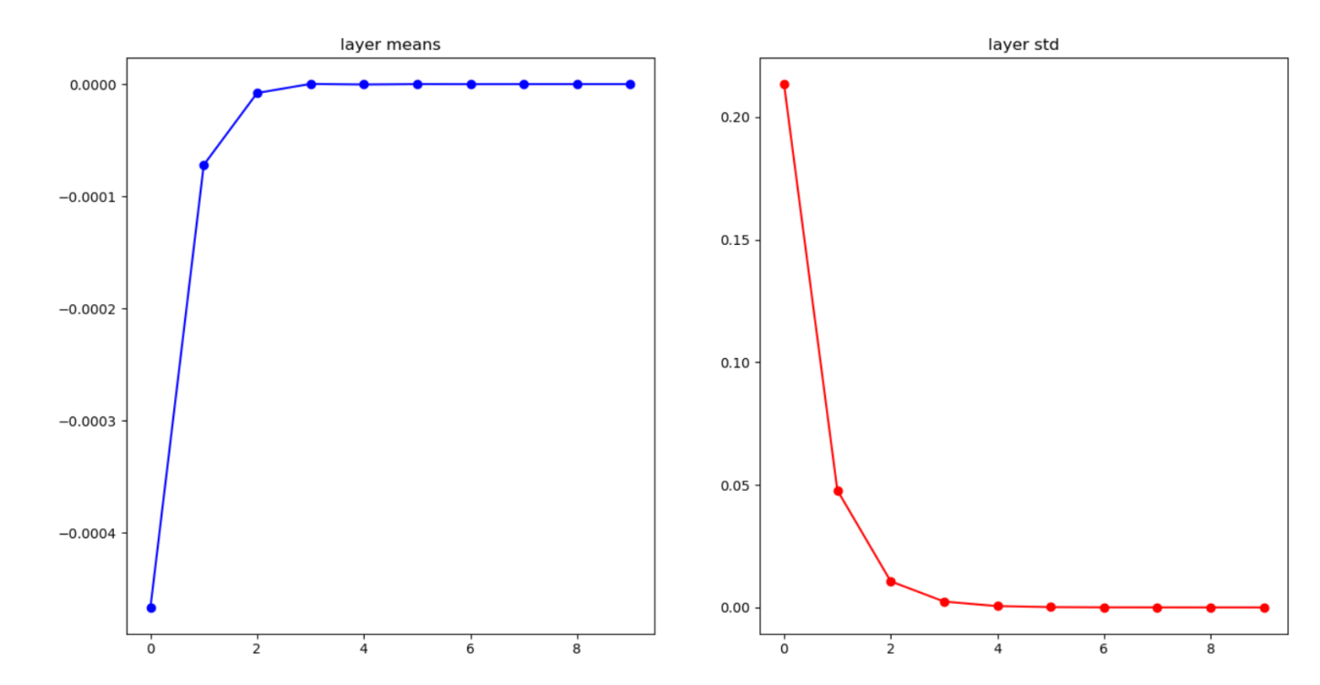
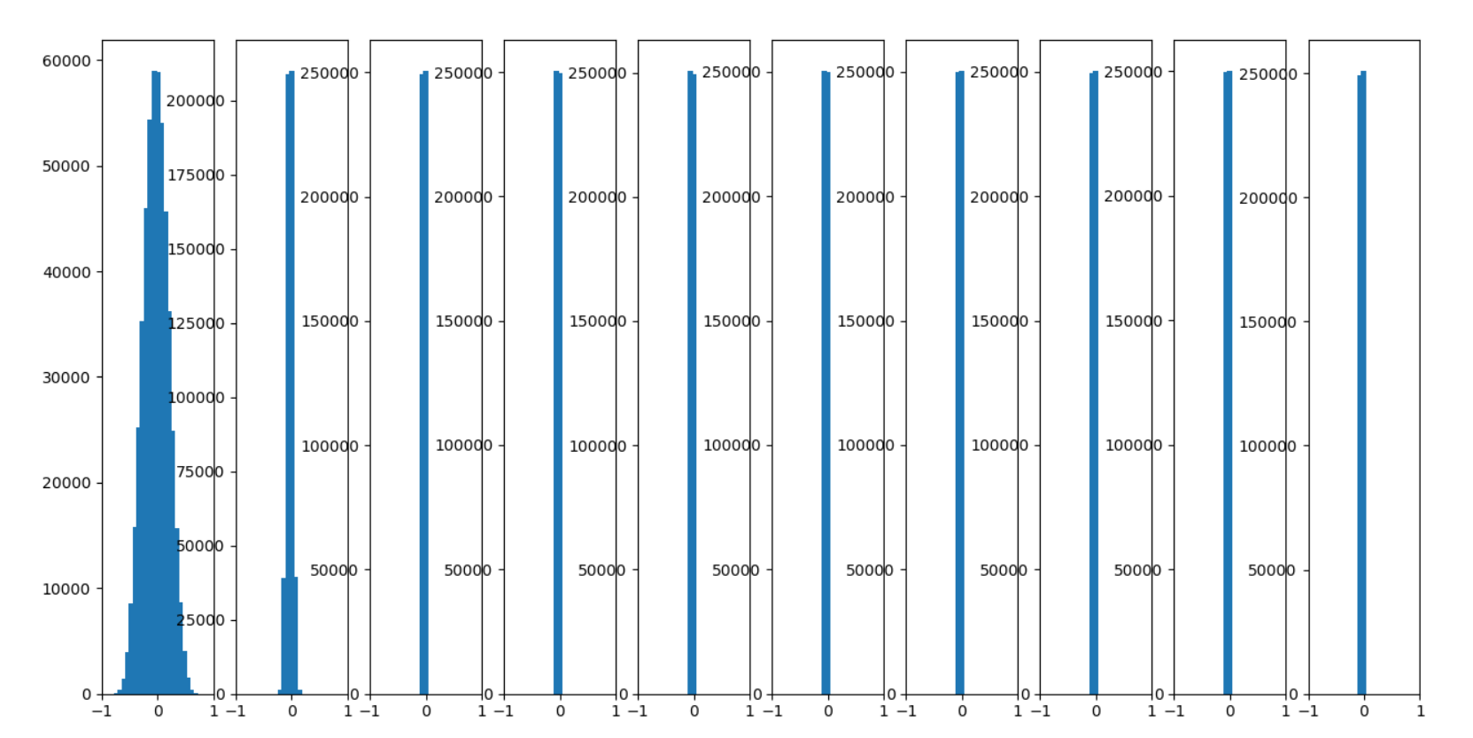
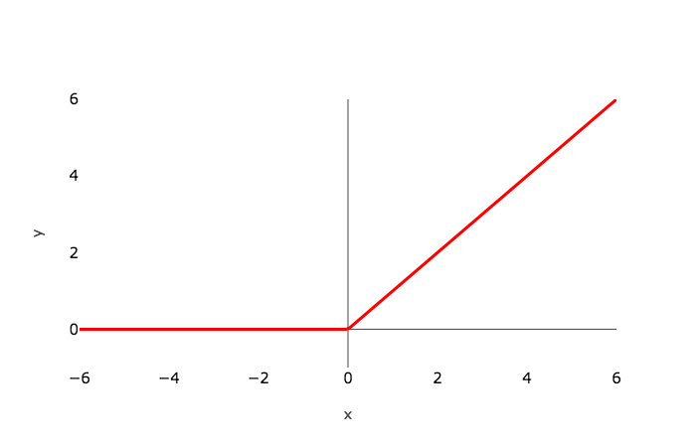
W = np.random.randn(in, out)*0.01
input layer had mean -0.001449 and stddev 0.999223
hidden layer 0 had mean 0.000289 and stddev 0.213667
hidden layer 1 had mean -0.000064 and stddev 0.047754
hidden layer 2 had mean -0.000001 and stddev 0.010667
hidden layer 3 had mean -0.000003 and stddev 0.002391
hidden layer 4 had mean 0.000000 and stddev 0.000535
hidden layer 5 had mean -0.000000 and stddev 0.000119
hidden layer 6 had mean 0.000000 and stddev 0.000027
hidden layer 7 had mean -0.000000 and stddev 0.000006
hidden layer 8 had mean 0.000000 and stddev 0.000001
hidden layer 9 had mean 0.000000 and stddev 0.000000

Slide 8
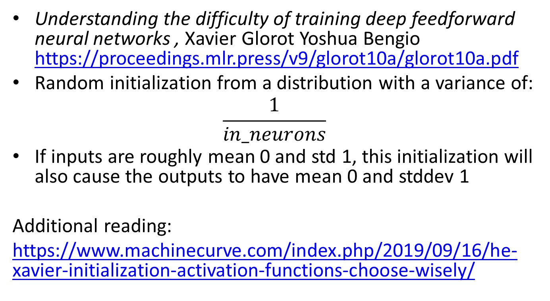
Xavier initialization
Understanding the difficulty of training deep feedforward neural networks , Xavier Glorot Yoshua Bengio https://proceedings.mlr.press/v9/glorot10a/glorot10a.pdf
Random initialization from a distribution with a variance of:
$$\frac{1}{in_neurons}$$
If inputs are roughly mean 0 and std 1, this initialization will also cause the outputs to have mean 0 and stddev 1
Additional reading:
https://www.machinecurve.com/index.php/2019/09/16/he-xavier-initialization-activation-functions-choose-wisely/

Slide 9
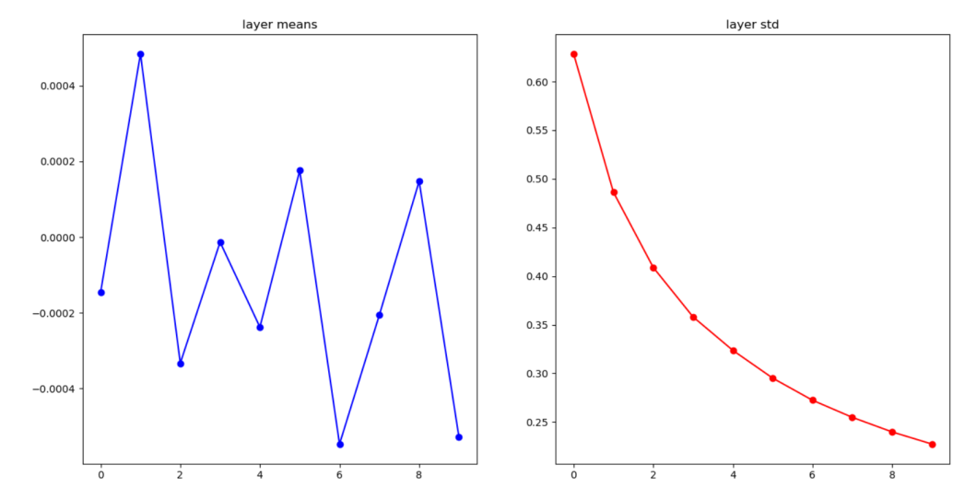
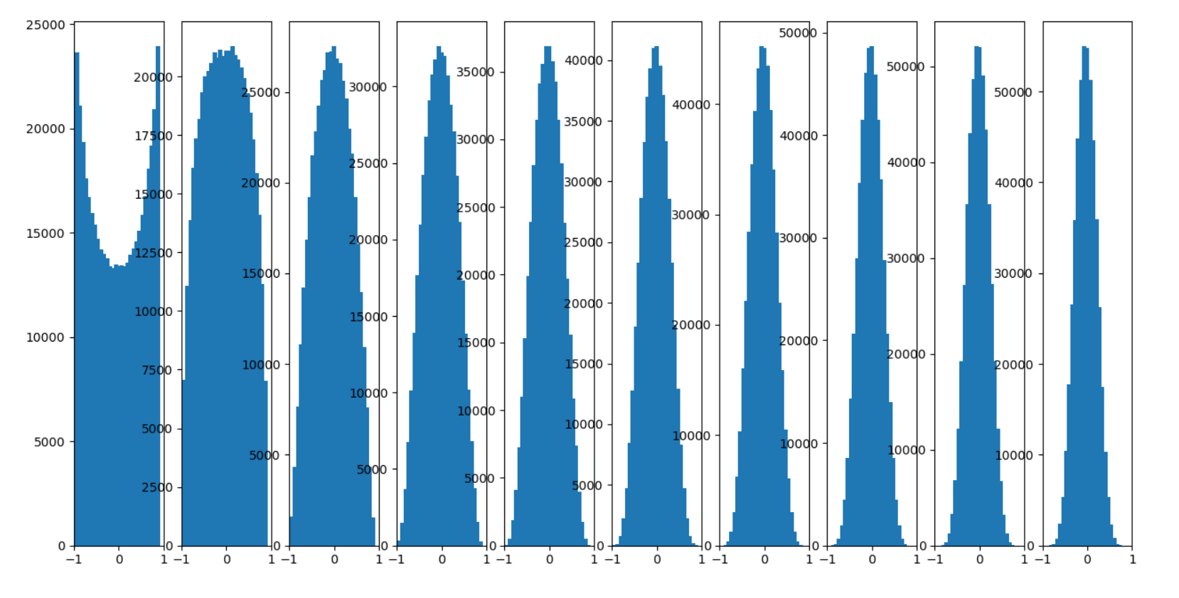
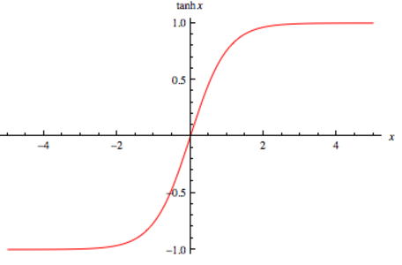
Xavier initialization
W = np.random.randn(in, out)/np.sqrt(in)
hidden layer 0 had mean -0.000145 and stddev 0.628485
hidden layer 1 had mean 0.000485 and stddev 0.486178
hidden layer 2 had mean -0.000333 and stddev 0.408851
hidden layer 3 had mean -0.000013 and stddev 0.358011
hidden layer 4 had mean -0.000238 and stddev 0.323565
hidden layer 5 had mean 0.000176 and stddev 0.295040
hidden layer 6 had mean -0.000547 and stddev 0.272295
hidden layer 7 had mean -0.000206 and stddev 0.254713
hidden layer 8 had mean 0.000148 and stddev 0.239710
hidden layer 9 had mean -0.000529 and stddev 0.227241

Slide 10
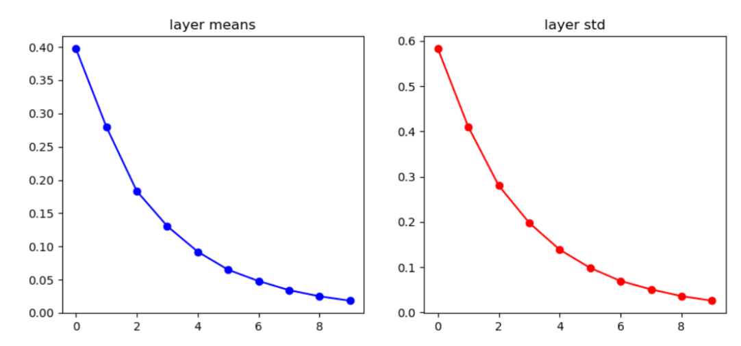
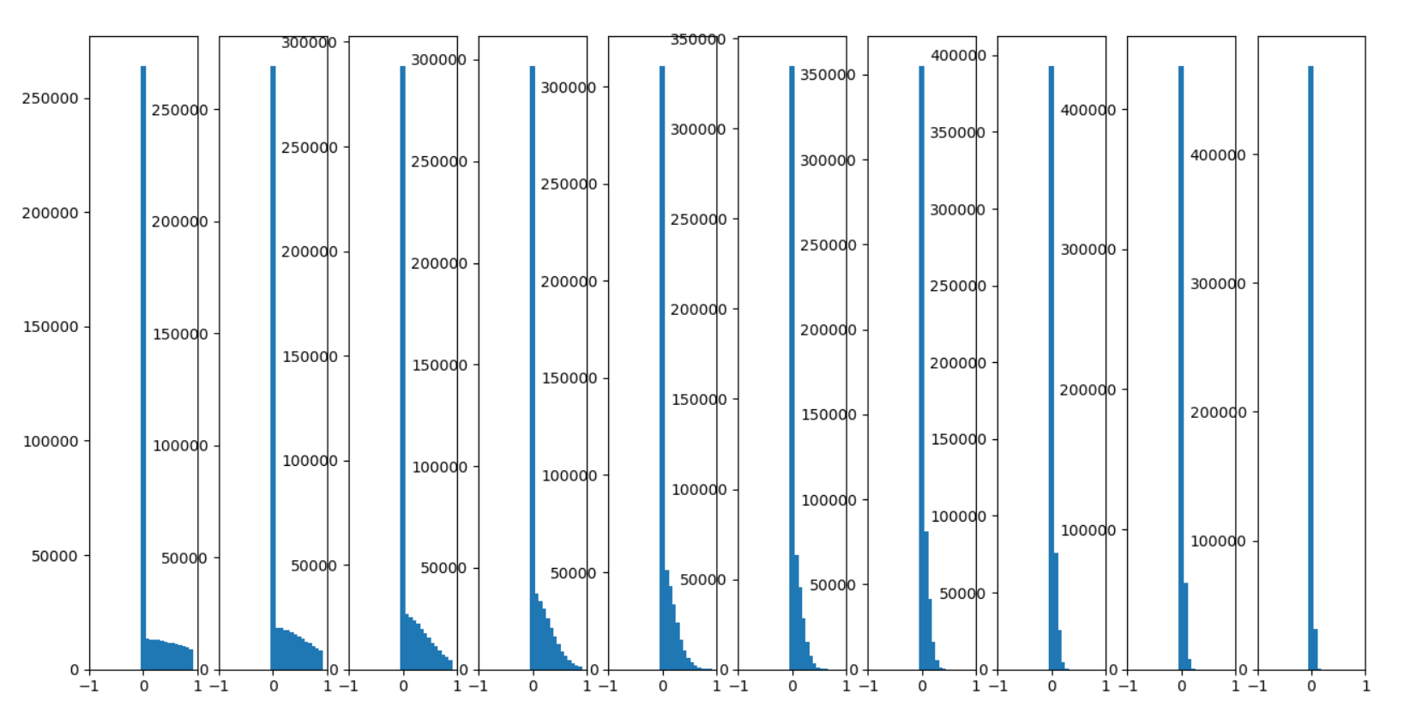
Xavier initialization
W = np.random.randn(in, out)/np.sqrt(in)
input layer had mean 0.000422 and stddev 1.000922
hidden layer 0 had mean 0.397685 and stddev 0.583384
hidden layer 1 had mean 0.280004 and stddev 0.410386
hidden layer 2 had mean 0.183151 and stddev 0.280291
hidden layer 3 had mean 0.130450 and stddev 0.198090
hidden layer 4 had mean 0.092056 and stddev 0.138666
hidden layer 5 had mean 0.064787 and stddev 0.098349
hidden layer 6 had mean 0.047867 and stddev 0.069325
hidden layer 7 had mean 0.034165 and stddev 0.050724
hidden layer 8 had mean 0.024928 and stddev 0.035902
hidden layer 9 had mean 0.018272 and stddev 0.025658

Slide 11
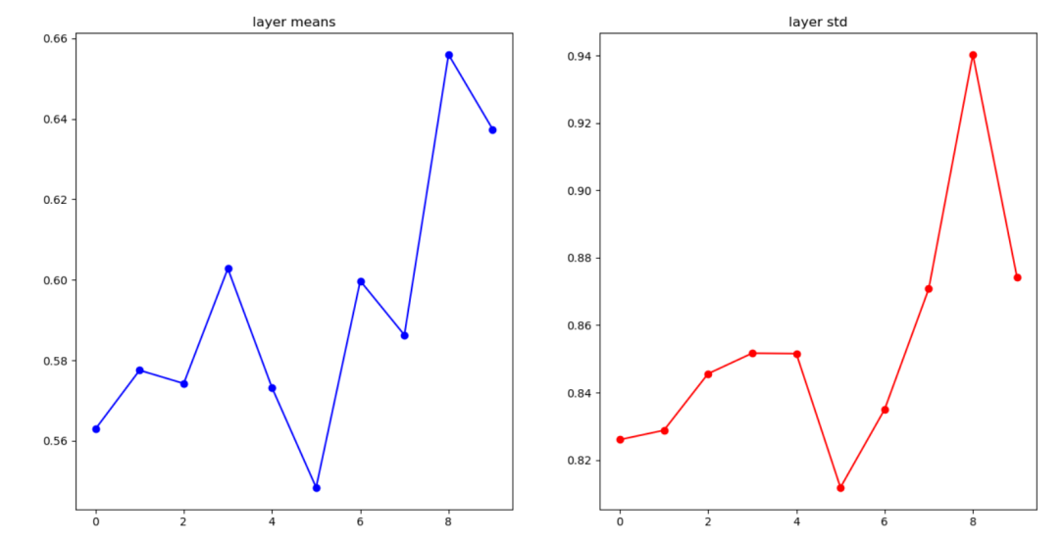
He initialization
W = np.random.randn(in, out)/np.sqrt(in/2)
input layer had mean -0.001160 and stddev 1.000333
hidden layer 0 had mean 0.562934 and stddev 0.826029
hidden layer 1 had mean 0.577537 and stddev 0.828810
hidden layer 2 had mean 0.574250 and stddev 0.845599
hidden layer 3 had mean 0.602799 and stddev 0.851682
hidden layer 4 had mean 0.573220 and stddev 0.851573
hidden layer 5 had mean 0.548410 and stddev 0.811833
hidden layer 6 had mean 0.599740 and stddev 0.834997
hidden layer 7 had mean 0.586302 and stddev 0.870794
hidden layer 8 had mean 0.655965 and stddev 0.940311
hidden layer 9 had mean 0.637412 and stddev 0.874220

Slide 12
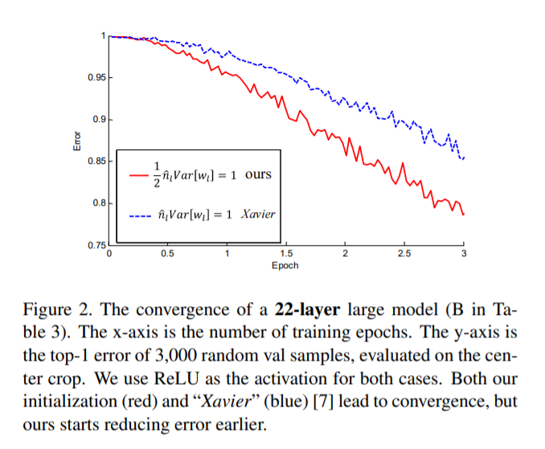
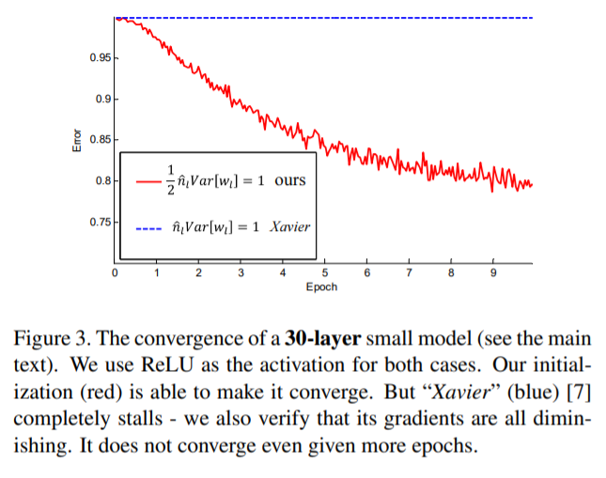
“Delving Deep into Rectifiers: Surpassing Human-Level Performance on ImageNet Classification” https://arxiv.org/pdf/1502.01852.pdf

Slide 13
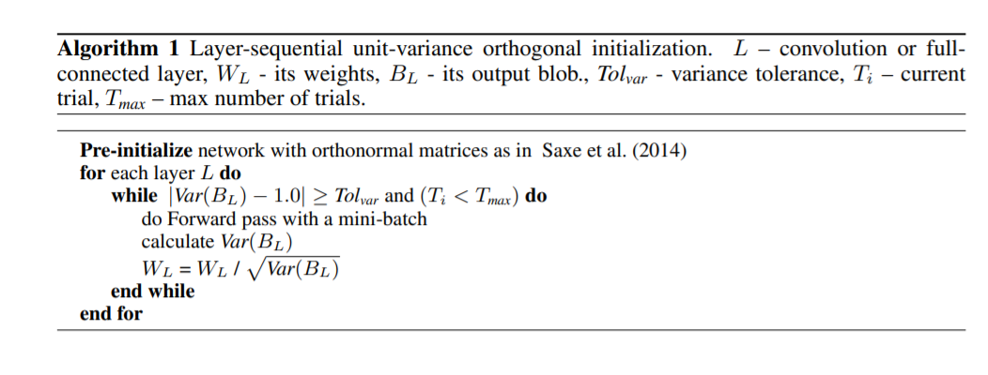
Data driven initialization
“All you need is a good init”: https://arxiv.org/pdf/1511.06422.pdf

Slide 14
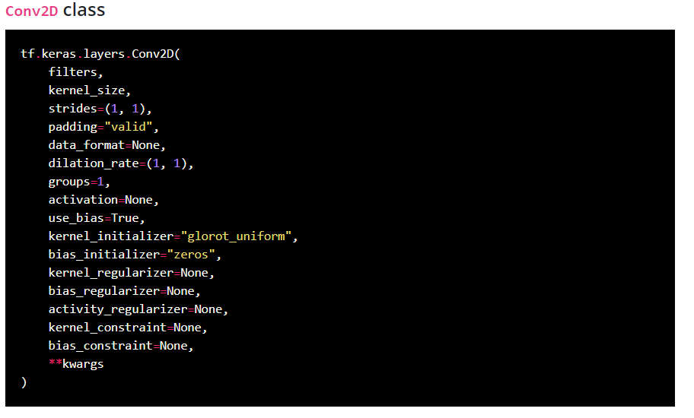
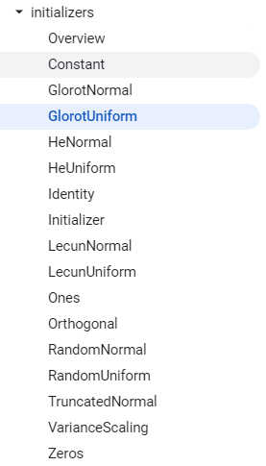
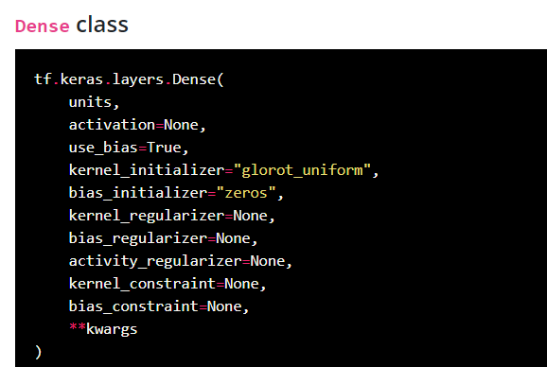
keras initialization

Slide 15
Training a neural network
Regularization

Slide 16
Regularization
Remember regularization techniques
L1 regularization
L2 regularization

Slide 17

Regularization
Weight decay
$J= \frac{1}{m}\sum_{1}^{m}{L\left(\hat{y_{i}}, y_{i}\right)+λ\frac{1}{2⋅m}{\sum_{1}^{l}{ }{\left\|W_{l}\right\|}_{F}^{2}}^{ }}$
${\left\|W_{l}\right\|}_{F}^{2}= \sum_{i=1}^{n_{l−1}}{ }\sum_{j=1}^{n_{l}}{{\left(w_{ij}^{ }\right)}^{2}}$

Slide 18
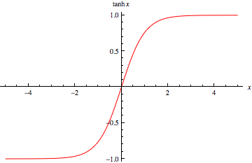
Regularization
Why does regularization reduce overfitting?

Slide 19
Exponential weighted averages

Slide 20
https://colab.research.google.com/drive/1CTSctxtN1JDvGZOswpLlG9ZkC4-s0ym2?usp=sharing

Slide 21
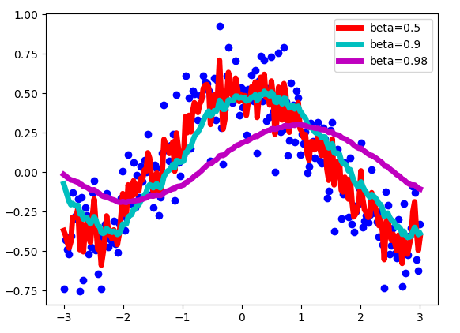

Exponential weighted averages
$$V_{t}=β⋅V_{t−1}+\left(1 −β\right)⋅x$$
https://towardsdatascience.com/stochastic-gradient-descent-with-momentum-a84097641a5d

Slide 22
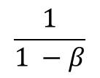
Exponential weighted averages
V_{t} approximates over:
$$\frac{1}{1 −β}$$
samples
https://towardsdatascience.com/stochastic-gradient-descent-with-momentum-a84097641a5d

Slide 24
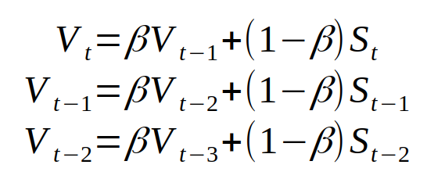
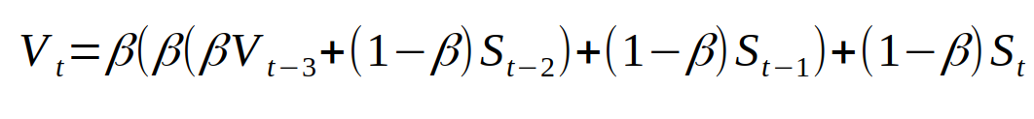
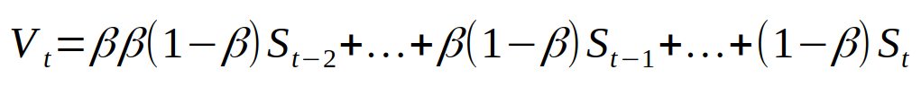
Exponential weighted average
The coefficients add up to approximately 1

Slide 25
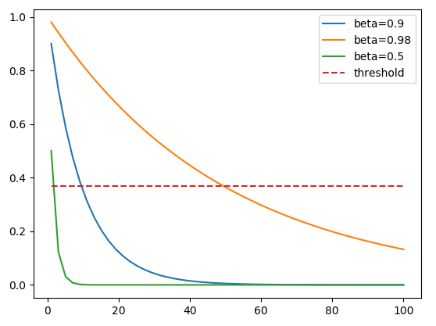
Exponential weighted average
threshold 1/e
(1 – ε)^{1/ ε} = 1/e

Slide 26
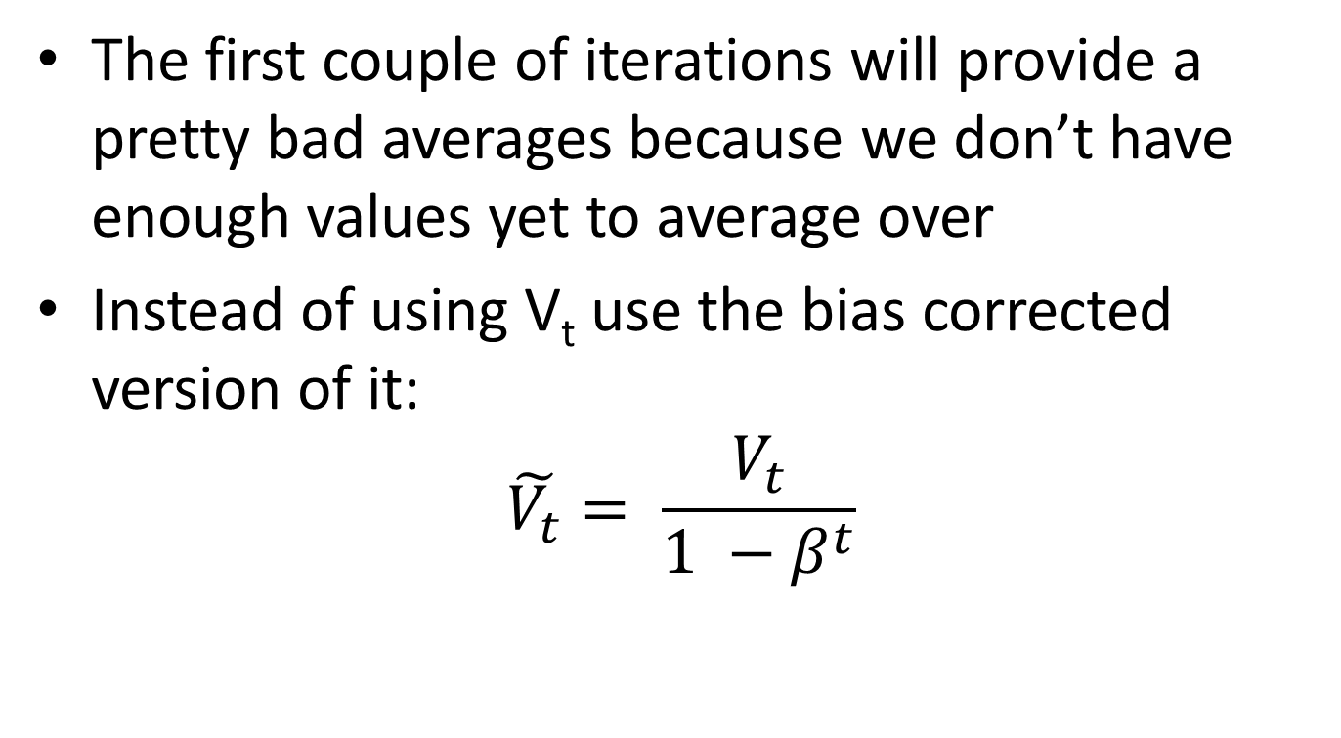
Exponential weighted average Bias correction
The first couple of iterations will provide a pretty bad averages because we don’t have enough values yet to average over
Instead of using V_{t} use the bias corrected version of it:
$$\tilde{V_{t}}= \frac{V_{t}}{1 −β^{t}}$$
https://www.youtube.com/watch?v=lAq96T8FkTw
https://www.youtube.com/watch?v=NxTFlzBjS-4
https://www.youtube.com/watch?v=lWzo8CajF5s – bias correction

Slide 27
Batch normalization
Compute mean and variance across each dimension
Normalize
D1
D2
D3
N
D

Slide 28
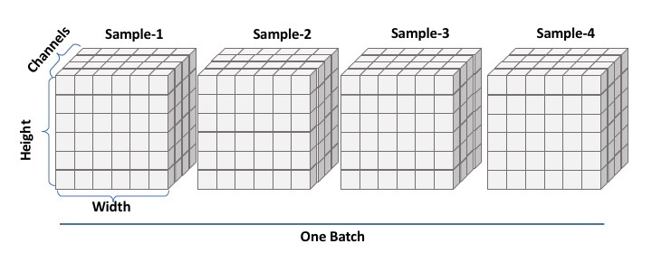
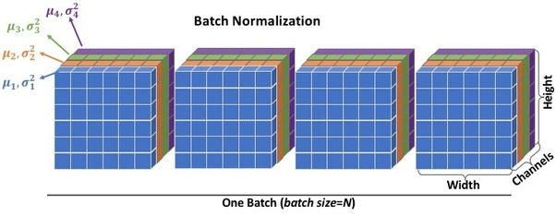
Batch normalization

Slide 29
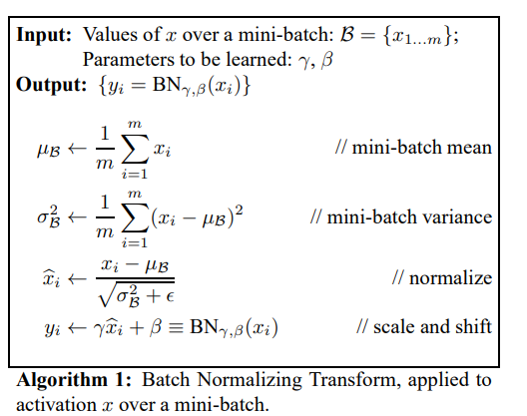
Batch normalization
Simple idea: just make the output of the linear units have 0 mean and unit standard deviation
algorithm source: https://arxiv.org/abs/1502.03167

Slide 30
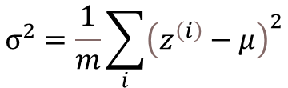
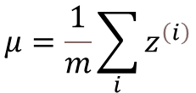

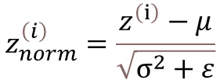
Batch normalization
Normalize:
$$μ=\frac{1}{m}\sum_{i}{z^{\left(i\right)}}$$
$$σ^{2}=\frac{1}{m}\sum_{i}{{\left(z^{\left(i\right)}−μ\right)}^{2}}$$
$$z_{norm}^{\left(i\right)}=\frac{z^{\left(ⅈ\right)}−μ}{\sqrt{σ^{2}+ε}}$$
Allow the network to modify the range
$${\tilde{z}}^{\left(ⅈ\right)}=γz_{norm}^{\left(i\right)}+β$$

Slide 31

Batch normalization
Normalize:
$$μ=\frac{1}{m}\sum_{i}{z^{\left(i\right)}}$$
$$σ^{2}=\frac{1}{m}\sum_{i}{{\left(z^{\left(i\right)}−μ\right)}^{2}}$$
$$z_{norm}^{\left(i\right)}=\frac{z^{\left(ⅈ\right)}−μ}{\sqrt{σ^{2}+ε}}$$
Allow the network to modify the range
$${\tilde{z}}^{\left(ⅈ\right)}=γz_{norm}^{\left(i\right)}+β$$
Can learn the identity function
$$γ=\sqrt{σ^{2}}$$
$β$ = $μ$

Slide 32
Batch normalization at test time
We cannot compute the mean and standard deviation on a batch of samples
Instead we use a static mean and standard deviation were computed empirically during training
Compute the mean and standard deviation on the entire training set
Estimate the mean and standard deviation using exponential weighted averages

Slide 33
Batch normalization (advantages)
Reduces the dependence on weights initialization
Improves gradient flow through the network
Allows you to set a higher learning rate
Slight regularization effect

Slide 34
Batch normalization
Further reading (batch normalization and transfer learning):
https://keras.io/guides/transfer_learning/

Slide 35
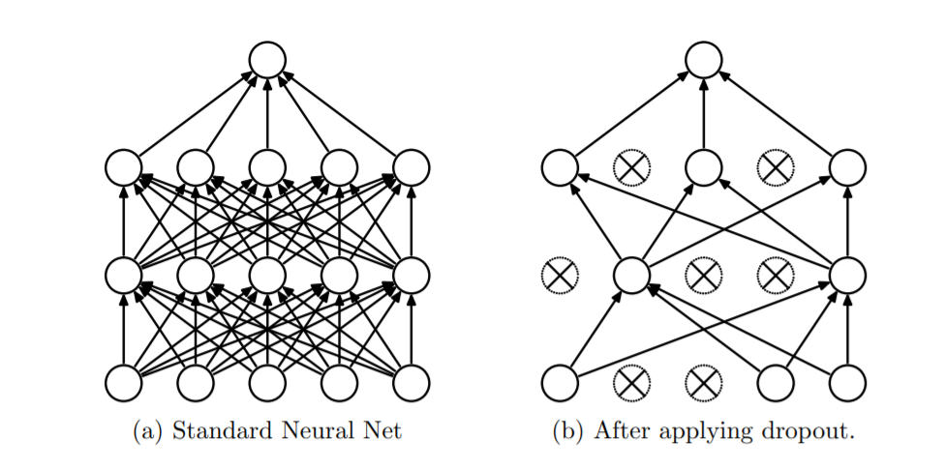
Dropout (2014)
Randomly drop units (and their connections) from the neural network during training
SRIVASTAVA, Nitish, et al. Dropout: a simple way to prevent neural networks from overfitting. The journal of machine learning research, 2014, 15.1: 1929-1958.
https://jmlr.org/papers/volume15/srivastava14a/srivastava14a.pdf

Slide 36
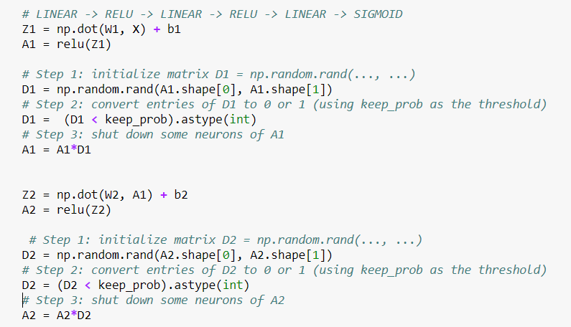
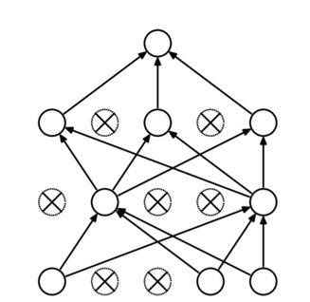
Dropout
keep_prop – probability of keeping a neuron; larger value, less dropout

Slide 37
Dropout visualization
Video source: https://www.coursera.org/learn/deep-neural-network/ungradedLab/xioPP/lab

Slide 38
Dropout intuition
At each iteration you actually modify your model:
train a different model that uses only a subset of your neurons
neurons thus become less sensitive to the activation of one other specific neuron (others neuron might be shut down at any time)

Slide 39
Dropout intuition
Train a large ensemble of models (with shared parameters)
Forces the model to have a redundant representation

Slide 40
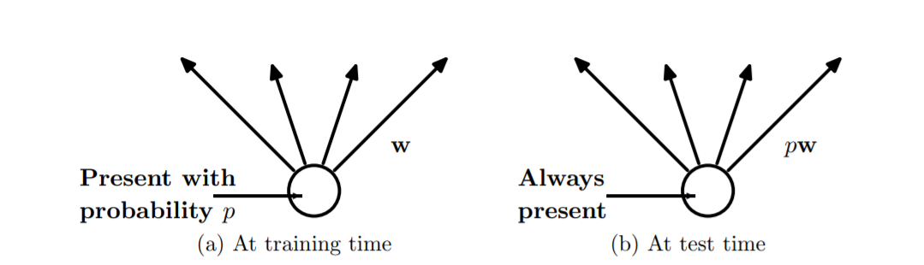
Dropout at test time

Slide 41
Dropout at test time
The neurons are always turned on
Scale the activation for each neuron
output at test time = expected output at training time

Slide 42
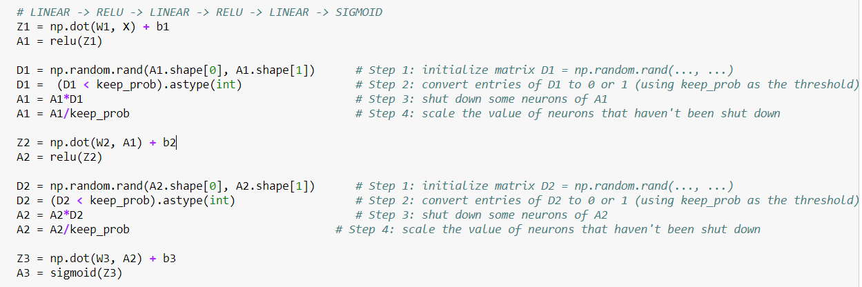
Dropout at test time
keep_prop – probability of keeping a neuron; larger value, less dropout

Slide 43
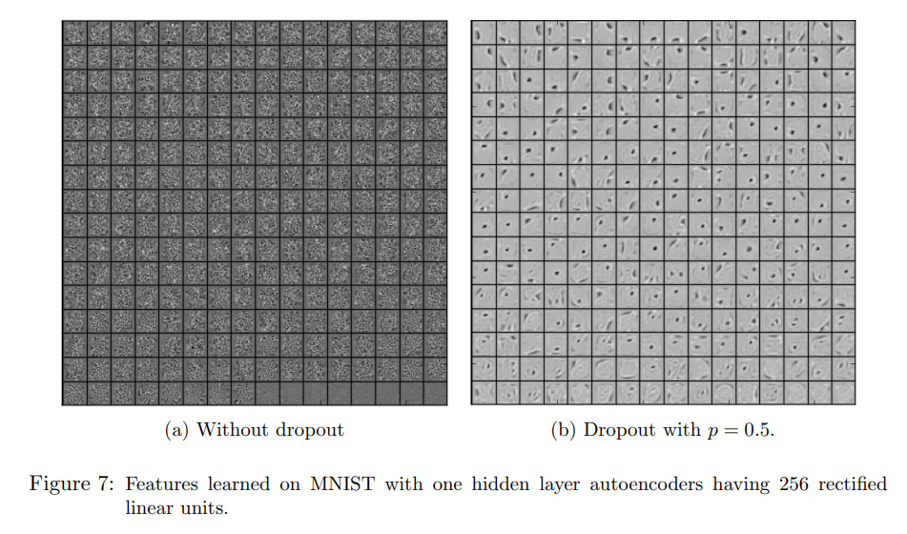
Dropout in practice
A hidden unit cannot rely on other specific units to correct its mistakes. It must perform well in a wide variety of different contexts provided by the other hidden units.

Slide 44
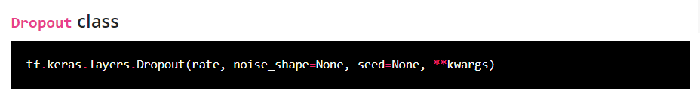

Slide 45
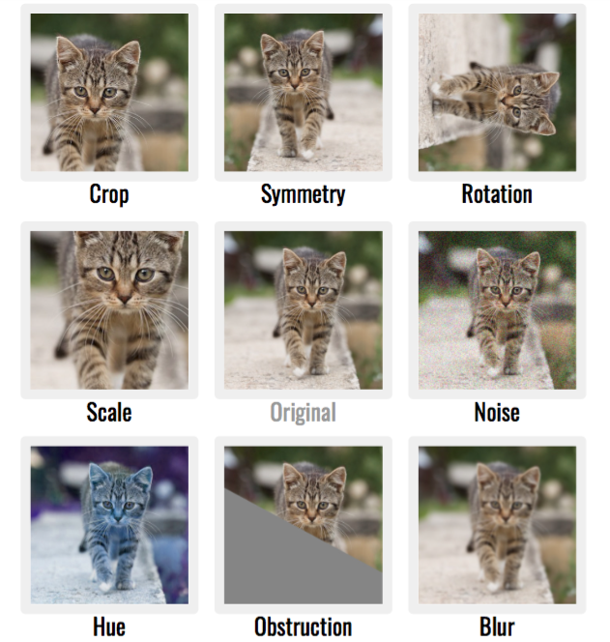
Data augmentation
Image source: https://mc.ai/easy-way-to-improve-image-classifier-performancepart-1%E2%80%8A-%E2%80%8Amixup-augmentation-with-codes-2/

Slide 46
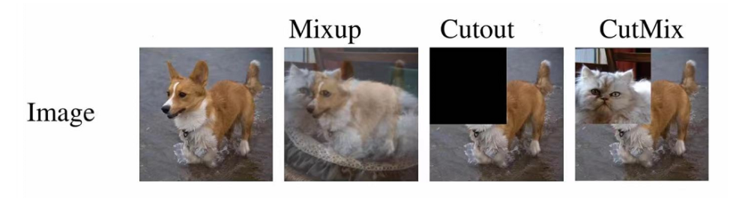
Data augmentation

Slide 47
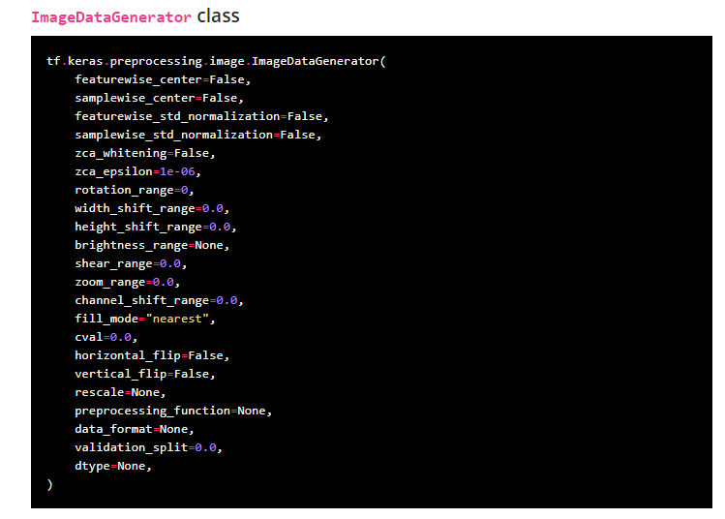
keras – data augmentation

Slide 48
Training a neural network
Optimization algorithms

Slide 49
Parameters update – gradient descent
Vanilla gradient descent:
Forward propagation through the network
Compute loss
Back-propagate to compute gradients
Update the parameters using the gradient

Slide 50
Parameters update – gradient descent
Batch gradient descent
“classical” implementation of gradient descent
Use vectorization and process the entire training set at the same time
Split the training set into mini-batches

Slide 51
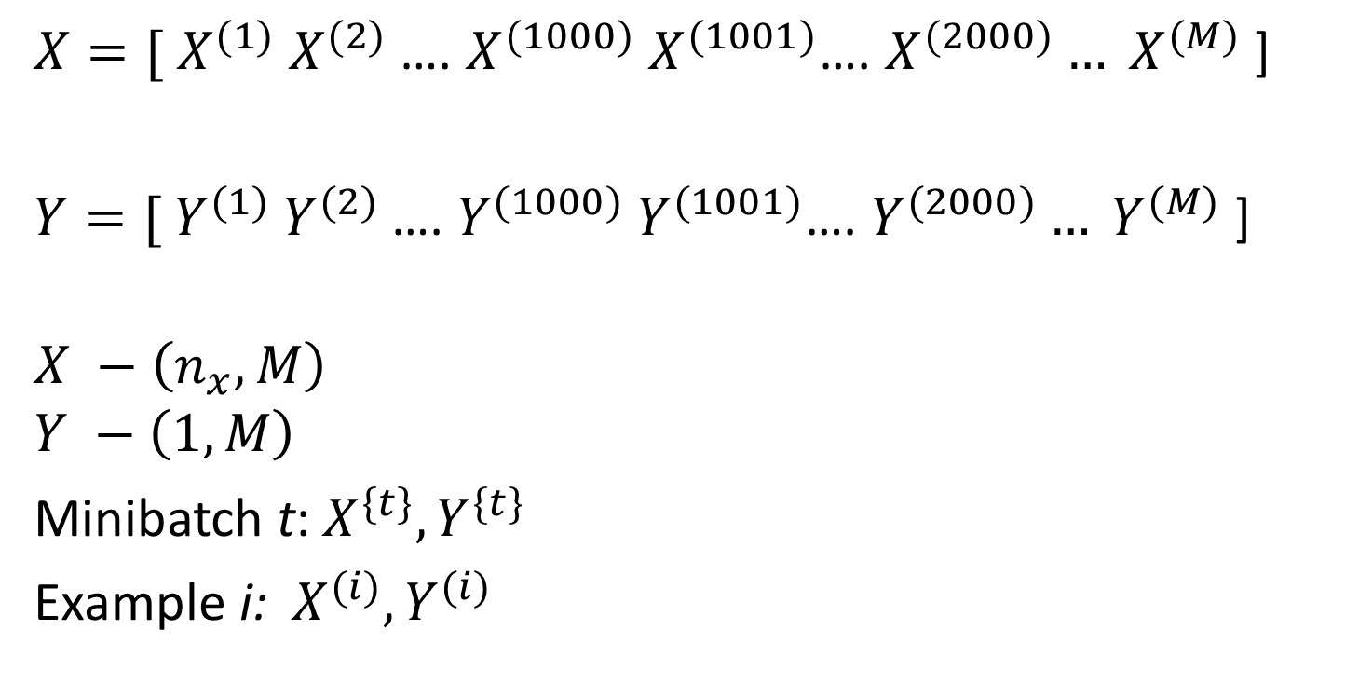
Parameters update – gradient descent
$X={[ X}^{(1)}$ $X^{(2)}$ …. $X^{(1000)}$ $X^{(1001)}$…. $X^{(2000)}… X^{(M)}$ ]
$Y={[ Y}^{(1)}$ $Y^{(2)}$ …. $Y^{(1000)}$ $Y^{(1001)}$…. $Y^{(2000)}… Y^{(M)}$ ]
$$X −\left(n_{x}, M\right)$$
$$Y −\left(1, M\right)$$
Minibatch t:${ X}^{\{t\}}, Y^{\{t\}}$
Example i: ${ X}^{(i)}, Y^{(i)}$

Slide 52
Parameters update – gradient descent
“Classical” gradient descent
Use vectorization and process the entire training set at the same time
Split the training set into mini-batches
while True:
batch = sample_batch(data) W_gradient = compute_gradient(loss_func, batch, W) # update parameters W += -lr*W_gradient

Slide 53
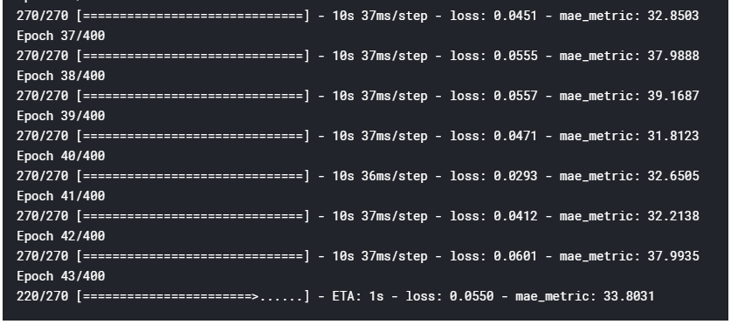
Mini-batch gradient descent
Epoch: single pass through the entire training set

Slide 54
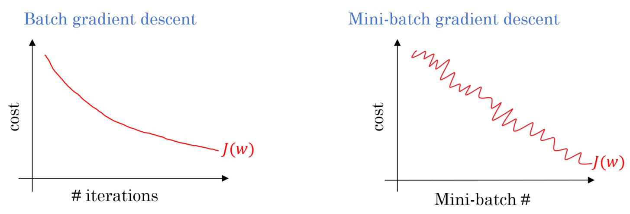
Size of the mini-batches
Stochastic gradient descent (m=1)
Mini-batch gradient descent
Batch gradient descent (m = M)

Slide 55
Size of the mini-batches
Stochastic gradient descent (m=1)
no vectorization, lose speedup
Mini-batch gradient descent
Fastest learning: use vectorization and doesn’t take top much time to update the weights
2⁶ , 2⁷ , …, 2¹⁰
Batch gradient descent (m = M)
Too much time per iteration

Slide 56
Parameters update – mini-batch gradient descent
foreach batch t:
Forward propagation through the network
Compute loss
Backpropagate to compute gradients
Update the parameters using the gradient

